Slide 1
Web Browsers
Nikit “Nefari0uss” Malkan
26 February 2015

Slide 2
Table of Contents
What is a browser?
Why should I care?
Brief History
Early Years
First Browser War
Second Browser War
Current Day & Future?
Major Browsers Past & Today
FireFox Propaganda

Slide 3
What is a web browser?
Why should I care?
And what’s in it for me?

Slide 4
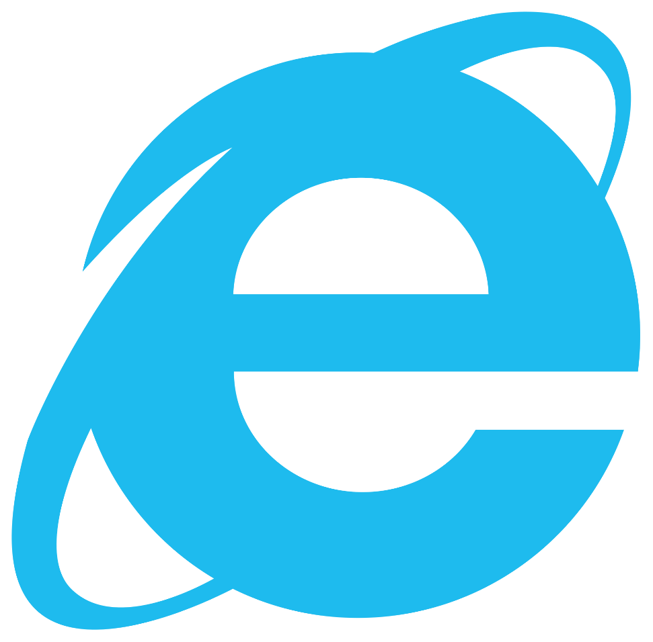
What is a web browser?
According to most users it’s the big blue E.

Slide 5
What is a web browser?
“A software application for retrieving, presenting and traversing information resources on the World Wide Web” (Wikipedia)

Slide 6
Well blah! That’s boring!
Let’s think about what we can use them for?

Slide 7
Why Should I Care/What Can MY Browser Do?
Browse the Internet
Huh, I would have never thought of that…

Slide 8
Why Should I Care/What Can MY Browser Do?
Browse the Internet
Access to information at your fingertips.
Entertainment

Slide 9
Why Should I Care/What Can MY Browser Do?
Browse the Internet
Access to information at your fingertips.
Vandalize Wikipedia!
Learn about all the hot sexy singles in your area!
Entertainment
These sites are only slightly shady…
And TOTALLY legal.

Slide 10
Why Should I Care/What Can MY Browser Do?
Connect with people anywhere in the world
Email & Chatrooms
Social Media
Blog Comments
VoIP

Slide 11
Why Should I Care/What Can MY Browser Do?
Connect with people anywhere in the world
Email & Chatrooms
Make new friends on Chat Roulette!
KAPPA
Social Media
I can be a SJW on Tumbler!
Blog Comments
All of the insightful YouTube comments.
VoIP
…I got nothing. Yet.

Slide 12
Why Should I Care/What Can MY Browser Do?
Browse the Internet
Access to information at your fingertips.
Entertainment
Connect with people anywhere in the world
Email & Chatrooms
VoIP
Social Media
Play/Edit media
Stream Music, Online Video, Live Streams
Edit Photos

Slide 13
Why Should I Care/What Can MY Browser Do?
Read Books/Documents – PDFs, eBooks
Create documents & presentations

Slide 14
Why Should I Care/What Can MY Browser Do?
Read Books/Documents – PDFs, eBooks
Create documents & presentations
SSH, FTP, Torrent, Remote Desktop Connection
Develop using cloud based IDEs

Slide 15
Why Should I Care/What Can MY Browser Do?
Read Books/Documents – PDFs, eBooks
Create documents & presentations
SSH, FTP, Torrent, Remote Desktop Connection
Develop using cloud based IDEs
Shitty (and awesome) Flash games
Actual games such as FTL, Bastion, Super Hexagon (asm.js, NaCl)

Slide 16
Why Should I Care/What Can MY Browser Do?
Read Books/Documents – PDFs, eBooks
Create documents & presentations
SSH, FTP, Torrent, Remote Desktop Connection
Develop using cloud based IDEs
Shitty (and awesome) Flash games
Actual games such as FTL, Bastion, Super Hexagon (asm.js, NaCl)
Be an OS? (ChromeOS, FirefoxOS) – Difficult to argue.
Virtual Reality? (Mozilla & Occulus Rift)

Slide 17
tl;dr – A lot more stuff then you thought.

Slide 18
Brief History

Slide 19
Brief History – What’s a Browser?
First web browser was WorldWideWeb.
For the NeXTstep platform.
Original code base for OS X.
Developed by Tim Berners-Lee.

Slide 20
Brief History – Answer? Magic!
First web browser was WorldWideWeb.
For the NeXTstep platform.
Original code base for OS X.
Developed by Tim Berners-Lee.
Released December 25, 1990
24 years ago!
Currently released under public domain.

Slide 21
Brief History – Mosaic Years
Many new browsers by 1993.
Most influential:
NCSA Mosaic Browser
National Center for Supercomputing Applications
By October 1994, Wired stated…
“well on its way to becoming the world's standard interface.”

Slide 22
Brief History – Mosaic Years
Marc Andreessen, a Mosaic developer founded Mosaic Communications Corporation.
Released Mosaic Netscape.

Slide 23
Brief History – Mosaic Netscape Years
Marc Andreessen, a Mosaic developer founded Mosaic Communications Corporation.
Released Mosaic Netscape.
Legal issues ensured.
Renamed to Netscape Communications Corporation
Similarly – Netscape Navigator.
Held majority market share.

Slide 24
Brief History – Microsoft Joins the Fray
Microsoft and Internet Explorer in 1995.
Licensed Mosaic to create Internet Explorer 1.0.
Released in MS Windows 95 Plus! Pack in August that year.

Slide 25
Brief History – Microsoft Joins the Fray
Microsoft and Internet Explorer in 1995.
Licensed Mosaic to create Internet Explorer 1.0.
Released in MS Windows 95 Plus! Pack in August that year.
Netscape held 86% market share by 1996.
Microsoft didn’t like that…
The First Browser War had begun.

Slide 26
Quick Sidenote – IT’S IMPORTANT MKAY
Why does it matter?
Popular web browser → Lots of money involved.
Default search engine deals.
Default bookmark list.
Lots of influence.

Slide 27
Brief History – MUH NEW FEATURES
Period of rapid development.
IE 2.0 released three months after 1.0.
NN and IE added tons of new features.
NEW FEATURES > ∞ > Boring bug fixes.

Slide 28
Brief History – Why aren’t we winning yet?
IE 4.0 changed the tide.
Was faster then NN 4.0.
Adopted W3C standards more faithfully.
Netscape still had 72% in 1997.
MS decided it was time to try some new tactics…

Slide 29
Brief History – Wait a minute…
Netscape derived most of it’s revenue from Navigator.
MS had this thing called Windows.
Speaking of which…
Windows had an OS monopoly.
This is gonna sound crazy but…

Slide 30
Brief History – You’re right. It’s crazy.
Netscape derived most of it’s revenue from Navigator.
MS had this thing called Windows.
Speaking of which…
Windows had an OS monopoly.
This is gonna sound crazy but…
What if IE came with Windows?

Slide 31
Brief History – Windows prints money!
MS integrated IE with Windows.
Good or bad, it increased market share.
Windows printed money!
Free with Windows OS
Funded development & marketing.
Money = Power
See Congress for additional details.

Slide 32
Brief History – We have infinite monies!
Licensing agreements with OEMs.
Required IE on desktop.
Penalized for shipping with Netscape.
Allowed ISPs to release branded versions of IE
Agreement with AOL to base interface off IE.
Purchased and released FrontPage.
Web authoring tool
Created pages that looked better in IE.

Slide 33
Brief History – It’s working!
Devastating effect
Reversed market share within 2 years (~1998).
Attained 96% at peak in 2002.
Netscape couldn’t fund their product anymore.
Open sourced their product.
Mozilla was born.
Thus ends the first browser war.

Slide 34
Brief History – It worked! But why?
Why did this work?
I thought Navigator was free…
Netscape’s business model
Browser for free.
Sell server software.

Slide 35
Brief History – Aim for the head air supply!
MS attacked their revenue stream.
Bundled Internet Information Server web sever for “free” with Windows server versions.
Offered MS customers clones of Netscape’s other severs.
Designed to “cut off Netscape’s air supply.”

Slide 36
Brief History – WE WON! YEAH!
Microsoft’s IE had killed Netscape Navigator.

Slide 37
Brief History – Damn it, not again…
Microsoft’s IE had killed Netscape Navigator.
From the ashes of it’s dead predecessor arose (Mozilla) Phoenix.
Renamed to Firebird due to trademark issues.
Renamed again to Firefox in 2004.
MS released IE6 in 2001.
Mozilla Firefox Firebird in 2002.
Apple Safari in 2003.

Slide 38
Brief History – Round Two! FIGHT!
Microsoft’s IE had killed Netscape Navigator.
From the ashes of it’s dead predecessor arose (Mozilla) Phoenix.
Renamed to Firebird due to trademark issues.
Renamed again to Firefox in 2004.
MS released IE6 in 2001.
Mozilla Firefox Firebird in 2002.
Apple Safari in 2003.
And so begins the second browser war.

Slide 39
Brief History – Ohh look! Shiny new features!
Opera
Tabbed browsing, mouse gestures, BitTorrent client
First to pass Acid2 test.
IE7
Search bar, Last to pass Acid2.
Firefox
2.0 – Reopen closed tabs, session restore, spell checker.
3.5 – Native audio/video, private browsing.
Safari
Webkit engine released in 2002/2003.
Google Chrome released in 2008.
Sandboxing

Slide 40
Brief History – Today
Chrome and Firefox have dethroned Internet Explorer.
Massive props to Google’s war chest and Mozilla’s stubbornness.
Massive innovation and changes take place.
Flash still completely not dead.
HTML5 please save us!
Mobile browsers surging.
Safari, Chrome on iOS.
Chrome, Firefox on Android.
IE on Windows Mobile.

Slide 41
IE6 PLS
IE6 is still a zombie.
As of Jan 2015, IE6 is used less then 1% in most countries.
China is 2.3% and Venezuela is 1.2%

Slide 42
Future?
Not sure how browsers will evolve.
With extensions, they can do crazy things.
Far beyond what people thought we could do 5 years ago.
Going back to earlier…
Cloud based development w/online workspaces?
Plugin-free games.
Be an OS (FirefoxOS?)
Virtual reality support.
Only two things are certain.

Slide 43
Please die.
Flash still sucks.
IE6 will remain a zombie.

Slide 44
Brief History
OK, so maybe it wasn’t so brief.
Moving on.

Slide 45
Major Browsers, Past and Current

Slide 46

WorldWideWeb
The very first.

Slide 47
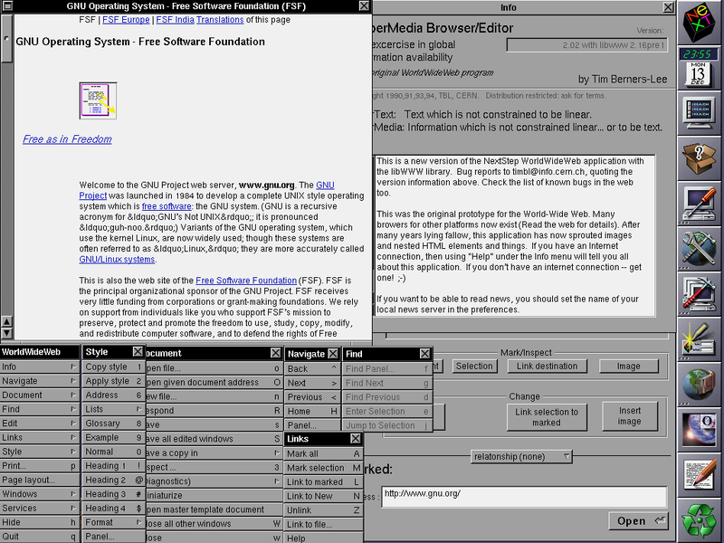
WorldWideWeb
Initial Release: 25 December 1990
24 years ago.
Developer: Tim Berners-Lee for CERN
OS: NeXTstep
Written in: Objective-C
JS Engine: What’s JavaScript?
Claim to fame: First web browser released.
Discontinued as of Jan 1994.
Currently in public domain.

Slide 48

NCSA Mosaic
Most influential?

Slide 49
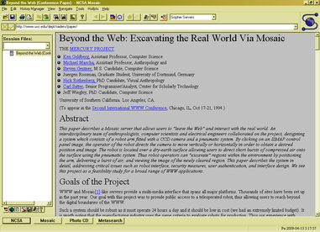
NCSA Mosaic
Initial Release: 23 Jan 1993
23 years ago.
Developer: NCSA
OS: AmigaOS, Mac OS, Unix, Windows
Written in: C
JS Engine: What’s JavaScript?
Proprietary License.
Claim to fame: The big 4 retain many characteristics of the Mosaic browser. Including a:
GUI
URL bar
Forward/back/reload buttons

Slide 50

Microsoft Internet Explorer
The browser to download other browsers.

Slide 51
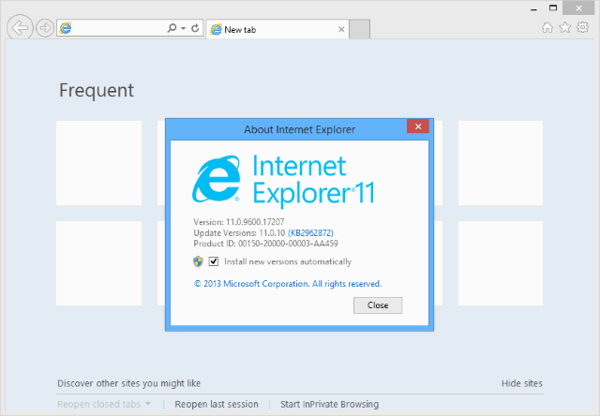
Internet Explorer
Initial Release: 16 August 1995
19 years ago.
Developer: Microsoft Corporation
Latest Release: IE11
OS: Windows, XBox, Windows Mobile
Written in: C++
JS Engine: Trident, Chakra, EdgeHTML (W10 only)
Proprietary License.
Claim to fame:
Being a web developer’s favourite browser to test with.
And always following accepted standards.
Biggest market share at peak.

Slide 52

Microsoft Project Spartan
To escape the legacy of IE.

Slide 53
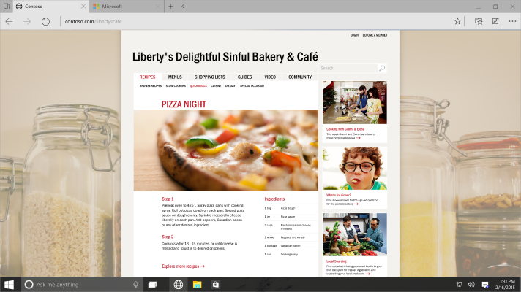
Project Spartan
Initial Release: With Windows 10.
2015?
Developer: Microsoft Corporation
OS: Windows 10, Windows Mobile
Written in: C++
JS Engine: EdgeHTML
Proprietary License.
Claim to fame:
It’s not IE.
Standards support!
Extensions?

Slide 54

Netscape Navigator
The loser.

Slide 55
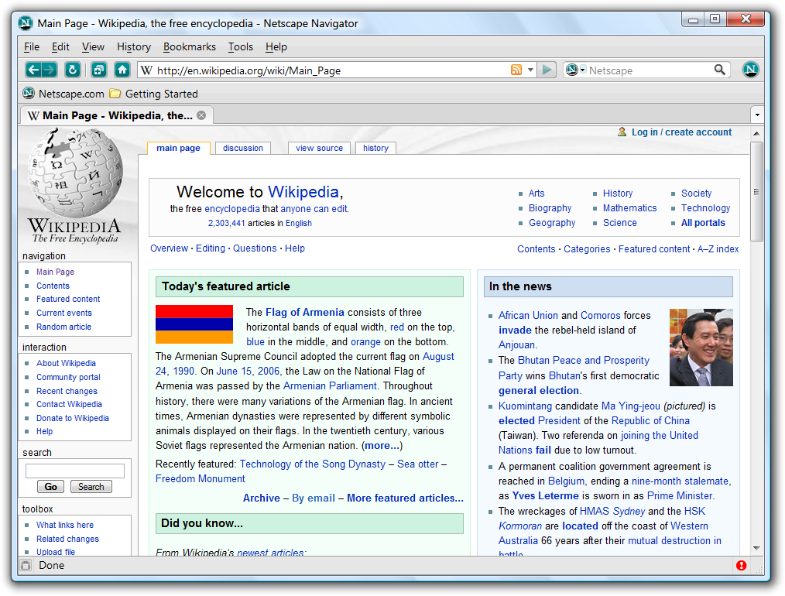
Netscape Navigator
Initial Release: 15 December 1994
20 years ago.
Developer: Netscape Communications Corp.
OS: Cross-Platform
Proprietary License.
Claim to fame:
Loser of the first browser war.

Slide 56

Mozilla Firefox
Different by Design.

Slide 57

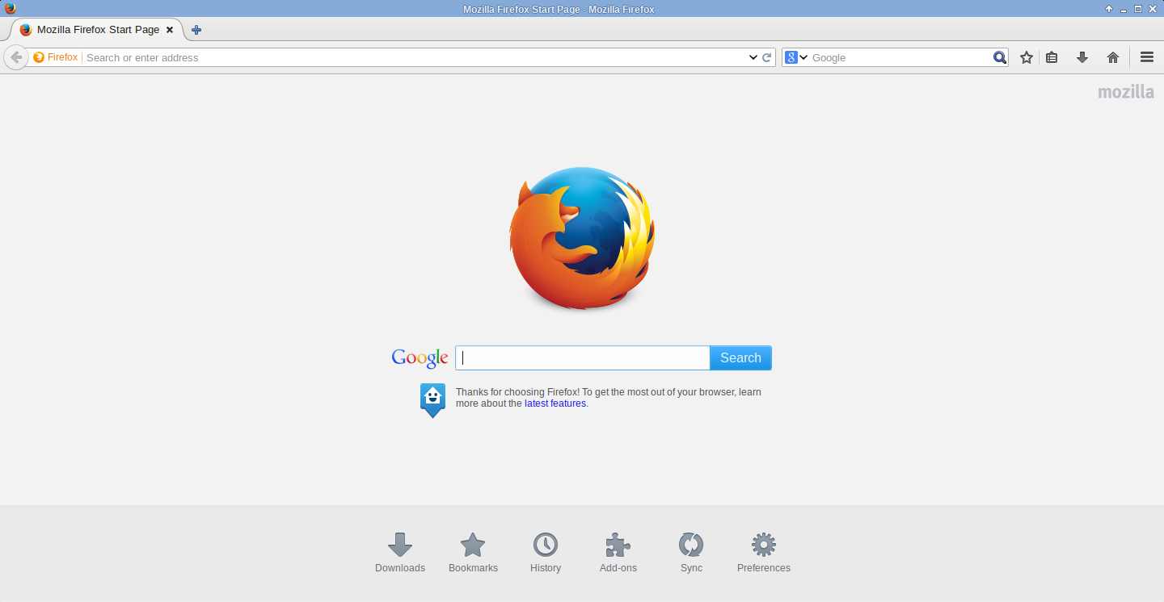
Mozilla Firefox
Initial Release: 23 September 2002
12 years ago.
Developer: Mozilla Corporation
Latest Release: 36 (Stable Branch)
OS: Windows, Mac, UNIX, Android, FirefoxOS
Written in: C++, JS, C, CSS, XUL, XBL
JS Engine: Gecko, Servo (experimental)
Mozilla Public License 2.0
Claim to fame:
Open Source
Extremely customizable.

Slide 58

Apple Safari
Comes free with your FaceBook machine!

Slide 59
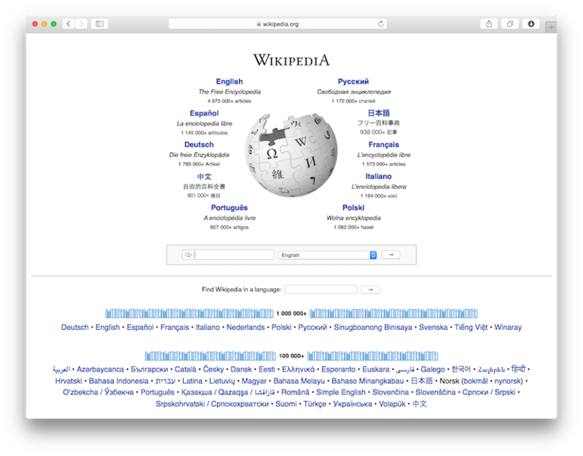
Apple Safari
Initial Release: 7 January 2003
12 years ago.
Developer: Apple Inc.
Latest Release: 8.0.3 (for OX X Yosemite)
OS: Mac, iOS
Written in: C++, Objective-C
JS Engine: WebKit, Nitro
Freeware, some parts GNU LGPL
Claim to fame:
Apple products only.
iOS version did not remove Flash.

Slide 60

Google Chrome
Give us your personal data!

Slide 61
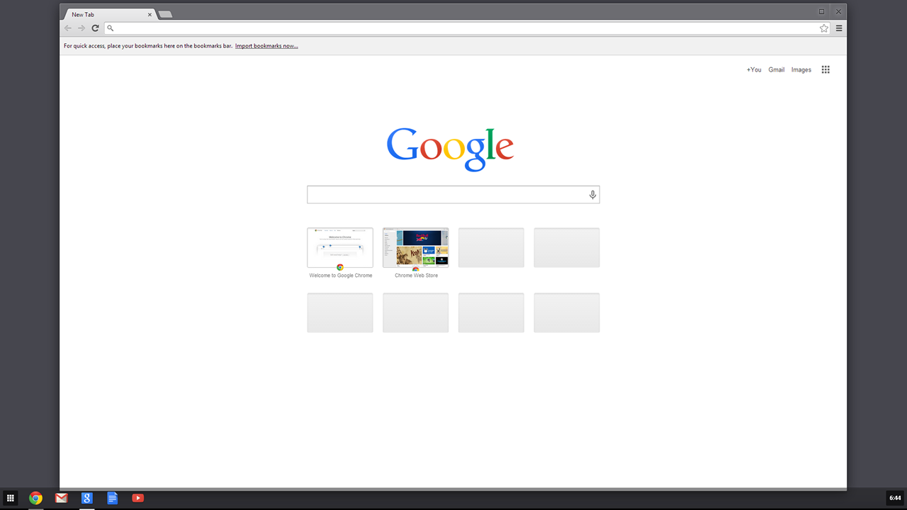
Google Chrome
Initial Release: 2 September 2008
6 years ago.
Developer: Google Inc.
Latest Release: 40.something
OS: Windows, Mac, UNIX, Android, iOS
Written in: C++
JS Engine: WebKit Blink
Google Chrome is closed source.
Chromium is open source.
Claim to fame:
Sandboxing model.
Google’s war chest.
6 week release cycle.

Slide 62

Opera
The Pioneer
Google Googleless Chrome

Slide 63
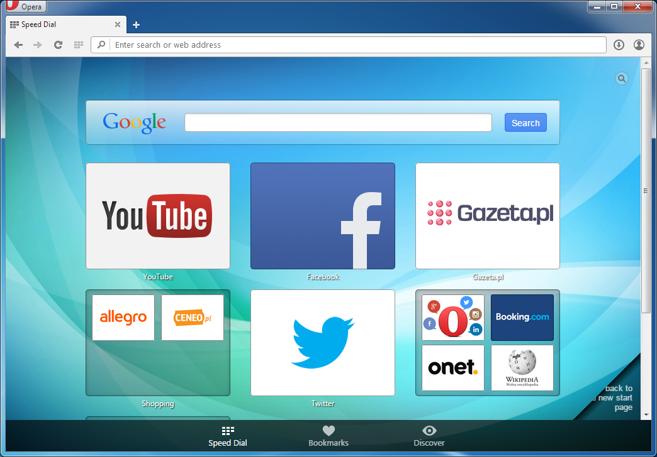
Opera
Initial Release: 1995
~19/20 years ago
Developer: Opera Software
Latest Release: 27.something
OS: Everything
Written in: C++
JS Engine: Presto Blink, V8
Claim to fame:
Used to be very innovative & feature rich
Tabs, Speed Dial, Pop-up blockers, Browser Sessions, etc.
Built in mail client, extension support, etc.
Is now essentially Chrome without Google branding.

Slide 64

Vivaldi
Opera with features.
Or as it used to be known, Opera.

Slide 65
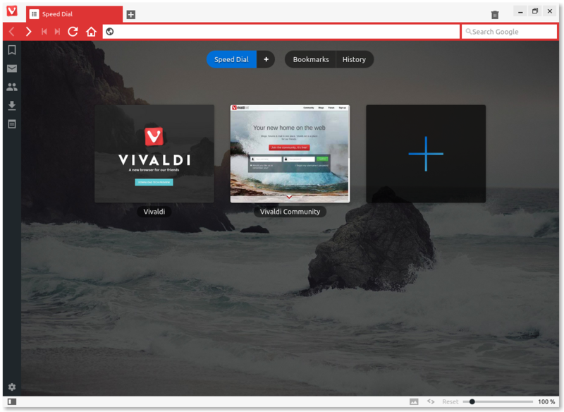
Vivaldi
Initial Release: In (public) preview
Developer: Vivaldi Technologies
OS: Windows, Linux, OS X
Written in: HTML5, Node.js, ReactJS
JS Engine: Blink
Claim to fame:
Meant to be a browser for power users.

Slide 66
Open Source Browsers
They’re there.
They exist.
Firefox is nice.
Chromium is pretty good.

Slide 67
Open Source Browsers
Midori
Lynx
Epiphany
Konqueror
Flock
Emacs (with a plugin)

Slide 68
Firefox Propaganda

